Slide 1
Statistical Tools and Concepts for Molecular Biologists
Data into Insights Part 1: Summary Statistics

Slide 2
Course Objectives
Improve the quality and efficiency of your research
Familiarity and working knowledge of frequently-used statistical analyses
Awareness of common mistakes and pitfalls
Learn by doing approach
In-class Assignments and optional take-home assessments

Slide 3
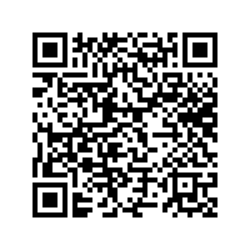
Learning Outcomes
Obtain summaries of data and make group-wise comparisons with confidence statements (p-values, t-tests, ANOVA, etc.)
Recognize statistical models, what they are, why we need them.
Summarize observations with many attributes using PCA and clustering
Data import and wrangling in R
Visualize and interpret data with ggplot
Build and evaluate statistical models in R
Perform dimensionality reduction and clustering in R
Poll: What is your level of expertise with these topics?
tinyurl.com/254DPreAssessment

Slide 4
Syllabus
Meeting | Content
W1-L1 | Lecture: Data to insights P1 | R: Getting Oriented
W1-L2 | Lecture: Data to insights P2 | R: Importing Data & Data Structures
W2-L3 | Lecture: Data to insights P3 | R: Data Wrangling
W2-L4 | Lecture: Data visualization strategies | R: Intro to ggplot
W3-L5 | In-class Assignment: Data visualization of bulk RNA-seq data
W3-L6 | Lecture: Intro to Statistical Models | R: Heatmaps, ANOVA, t-tests
W4-L7 | Lecture: Linear Regression | R: Regression plotting and R2
W4-L8 | Lecture: Multivariate Statistics | R: PCA plot and k-means clusters
W5-L9 | Lecture: Intro to scRNA-seq analysis | R: Seurat R package basics
W5-L10 | In-class Assignment: scRNA-seq analysis & visualization

Slide 5
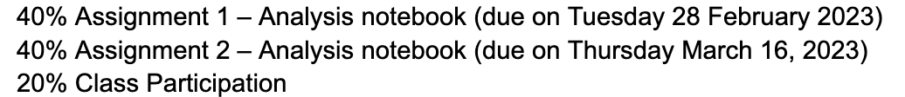
Grading Breakdown

Slide 6

Virtual Office Hours
Would you like office hours to be recorded and posted on BruinLearn?

Slide 7
Analyzing data to gain insight into our world (Sessions 1-3)
Inferring population traits from a random sample
Statistical summaries
Distributions
Hypothesis testing and p-values
Multiple testing, p-hacking, and permutations

Slide 8
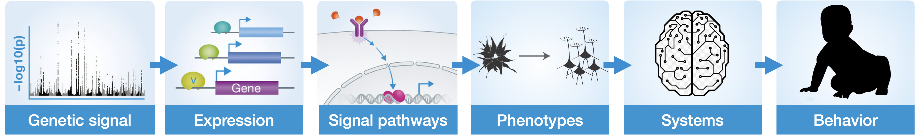
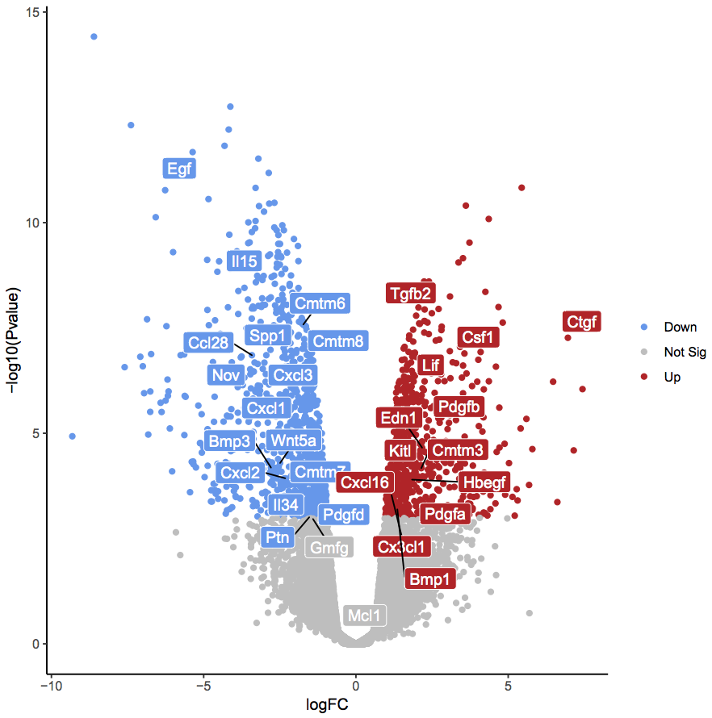
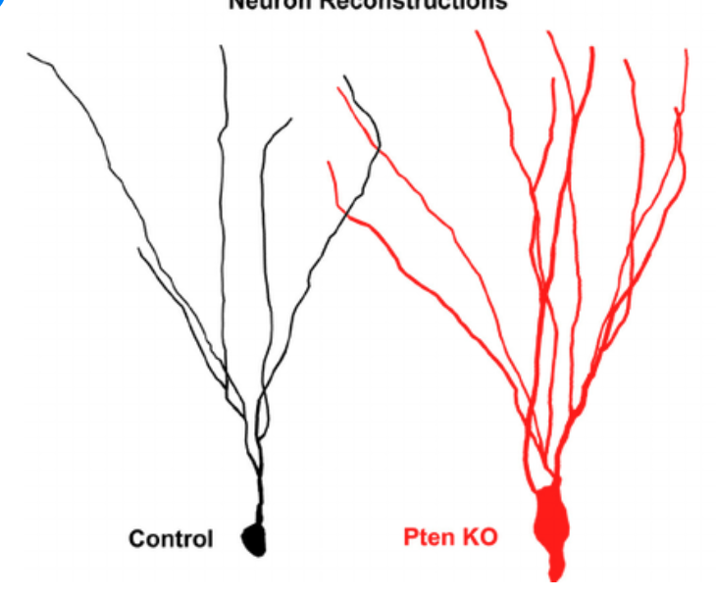
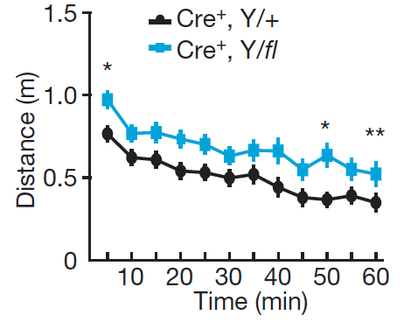
The power of being equipped with statistical tools
Control
Knockout

Slide 9
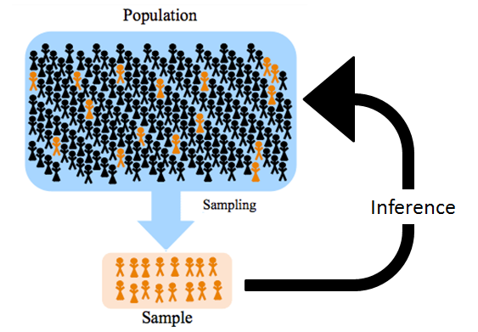
Inferential statistics: Sample to population
In most cases, it is impossible to collect data from the entire population.
We therefore sample the population and then draw conclusions about actual population from small sample
There is uncertainty in our conclusions
We will assume that there are no sampling errors or selection bias for this course
Notes:
Selection bias: political pollsters using landlines to sample voting population

Slide 10
Descriptive Statistics: Data Summaries
Mean
Median
Variability
Extreme values (min, max)

Slide 11
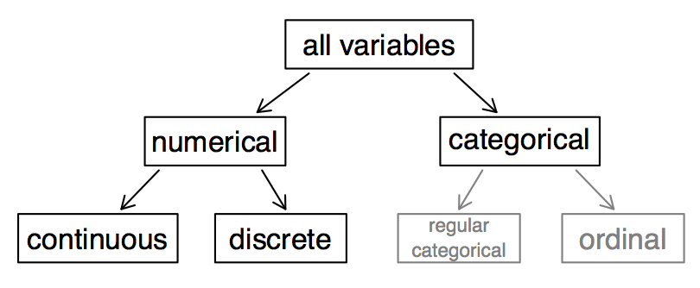
Types of random variables/data that we collect
A random variable is a numeric quantity whose value depends on the outcome of a random event, experiment, or trial
Real (Decimal) values
Height
ICC signal intensity
Normalized Gene expression
Integer values
People
Marker positive cells
Transcript number
Groups
Hair color
Genotype
Cell type identity
Ranked Groups
High school/B.S./PhD
Low/mid/high
Stem cells/progenitors/
differentiated
Notes:
Binary variable: categorical variable with one of two possible outcomes. Sometimes called “dummy” variable.

Slide 12
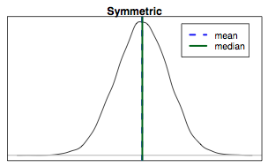
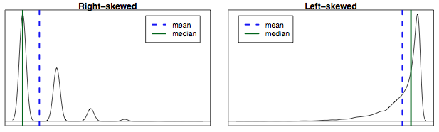
Measures of Central Tendency: Mean vs. Median
Mean is the average of a set of values
Median is the middle (or 50th percentile) of a set of values
If the distribution is symmetric: mean ~ median
If the distribution is skewed or has extreme outliers, center is often defined as the median

Slide 13
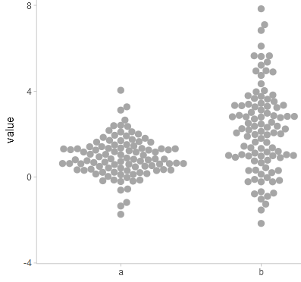
Variability (or Variation)
Variability refers to the spread or dispersion of your data
There are several measures of variability:
Interquartile range
Min/Max
Variance
Standard deviation
Standard error

Slide 14
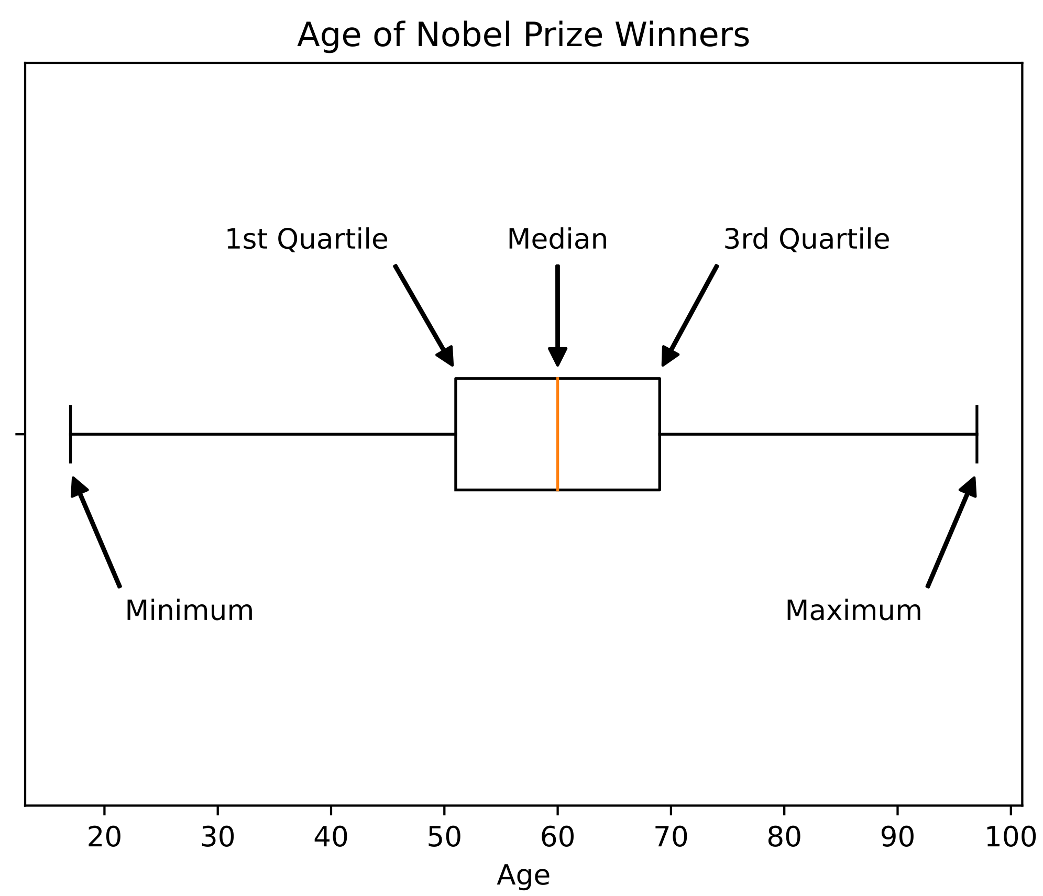
Interquartile range & Min/Max
Interquartile range is a measure of the “middle 50%” of your data.
Calculated by subtracting the 25th percentile from the 75th percentile
The Minimum is the lowest value in your dataset and the Maximum is the highest.
5-number summary: Min, Max, Median, 25th percentile, & 75th percentile

Slide 15
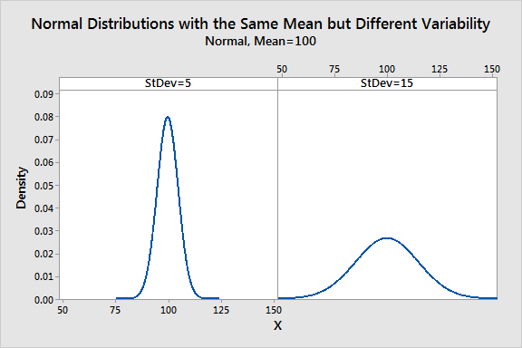
Variance & Standard Deviation
Variance can be calculated by subtracting the mean from each value, squaring the result, and averaging these squared differences.
Unlike range, takes into account spread of all data points
Useful for identifying outliers
Standard deviation is the square root of variance
More commonly used than variance
Gives spread in same units as observations
~2/3 of data usually within ±1 SD of mean
Notes:
Difference between variance and standard deviation: https://www.youtube.com/watch?v=CVF9lr9mpes
Variance is commonly used in statistical theory, but not run of the mill analysis

Slide 16
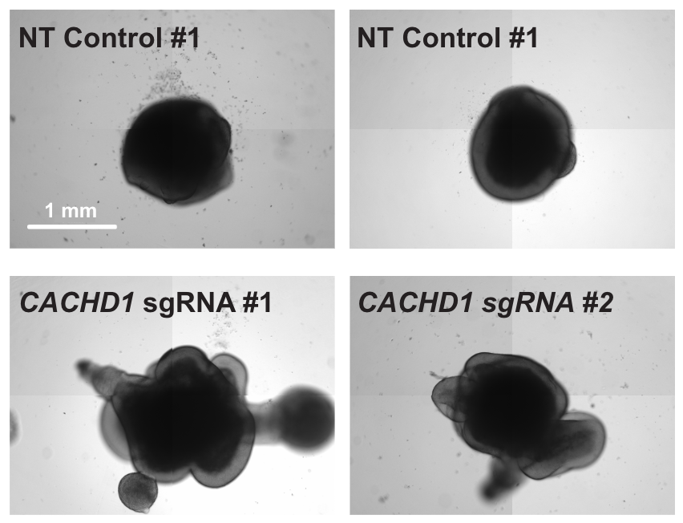
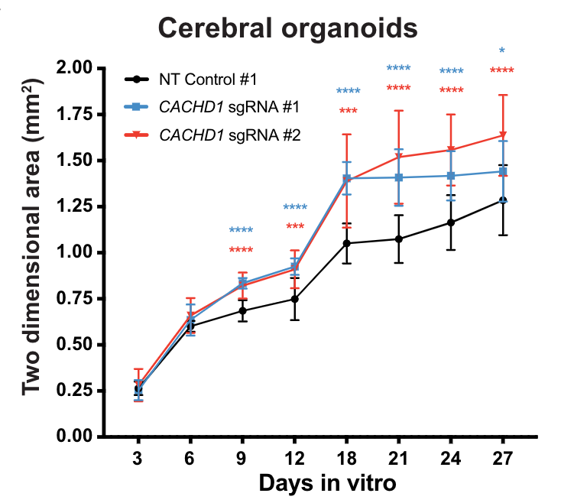
USE CASE: Impact of CACHD1 gene knockout
Wells et al., Unpublished

Slide 17
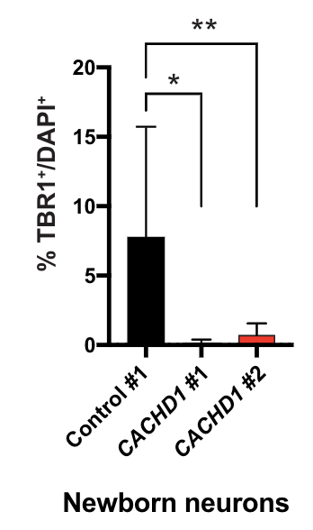
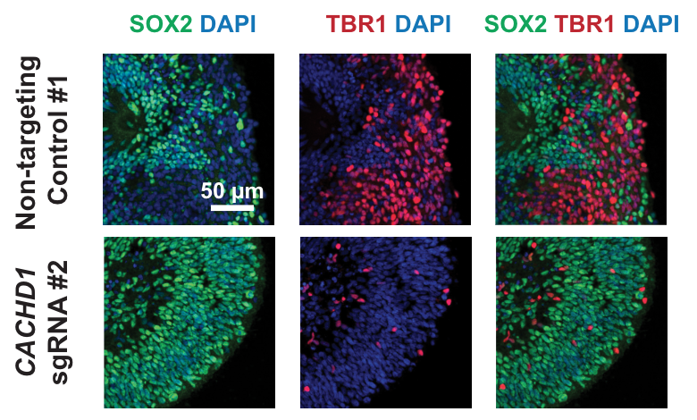
USE CASE: Impact of CACHD1 gene knockout
Wells et al., Unpublished

Slide 18
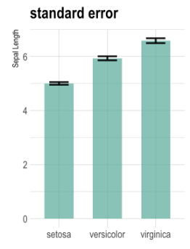
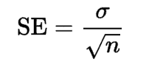
Standard Error
Standard error is a measure of the accuracy of a sample estimate as it relates to actual population
Involves repeatedly calculating sample means from the same population and quantifying variation
Essentially measures sampling error
Can be estimated from a single set of measurements by dividing sample standard deviation by number of samples:
Notes:
Standard deviation vs standard error: https://www.youtube.com/watch?v=A82brFpdr9g
SEM is not necessarily a measure of the variation of the data you measured.

Slide 19
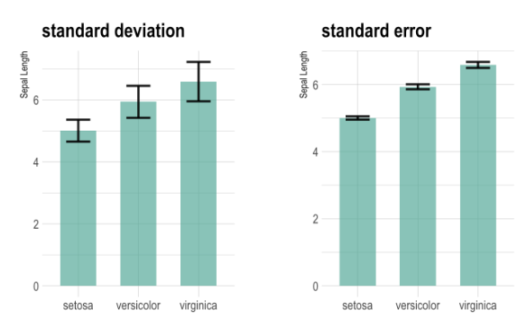
PITFALL: SEM vs SD
In most cases, you should plot standard deviation rather than standard error since your goal is to describe the data that you measured (i.e., sample population, not actual population)
Standard error will always be smaller than standard deviation, so using SEM as a measure of variance can at times be deceptive.
Regardless, always state in your figure legend what metric was used.

Slide 20
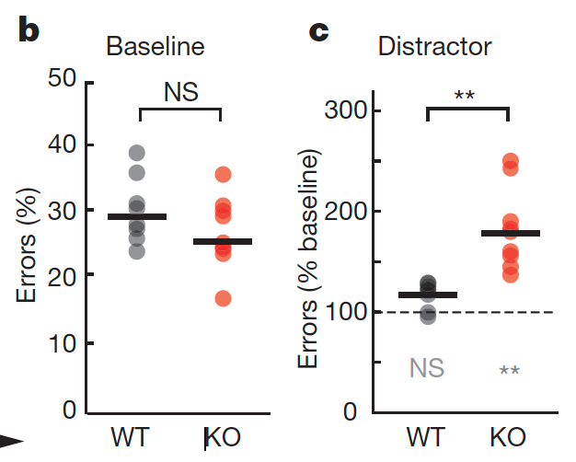
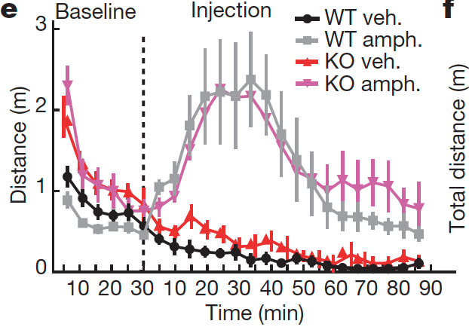
PITFALL: SEM vs SD
VERY common in mouse behavior studies that have high variation and low sample size. Either plot SD or show all values.
Wells & Wimmer et al., Nature 2016

Slide 21
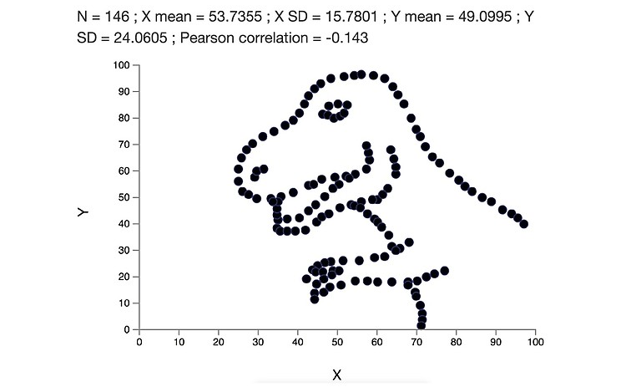
PITFALL: Never trust summary statistics alone
More on this in Lecture 4

Slide 22
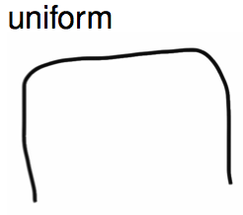
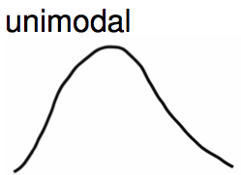
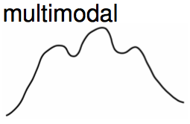
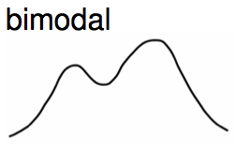
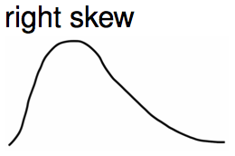
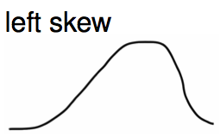
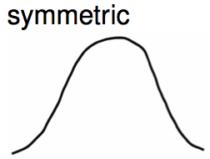
Data distribution
Distribution shows all the possible values in a dataset as well as the frequency of each value
Modality
Skewness

Slide 23
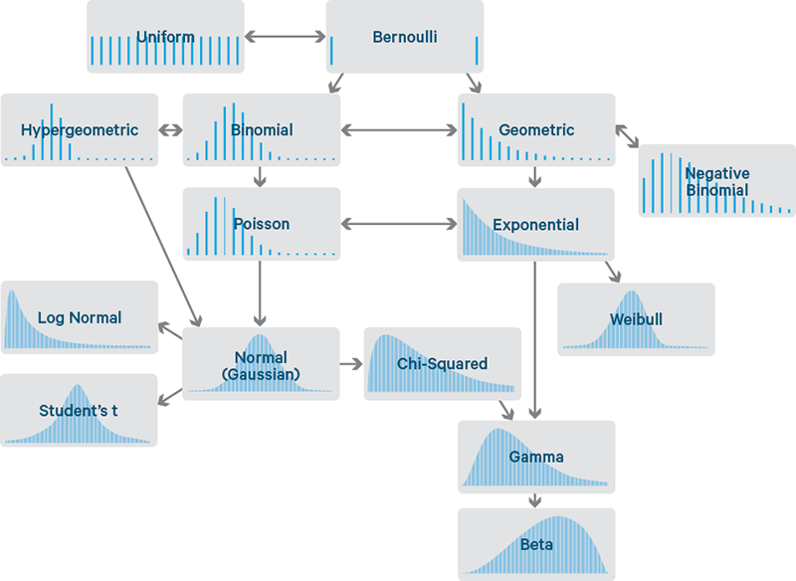
Data distribution

Slide 24
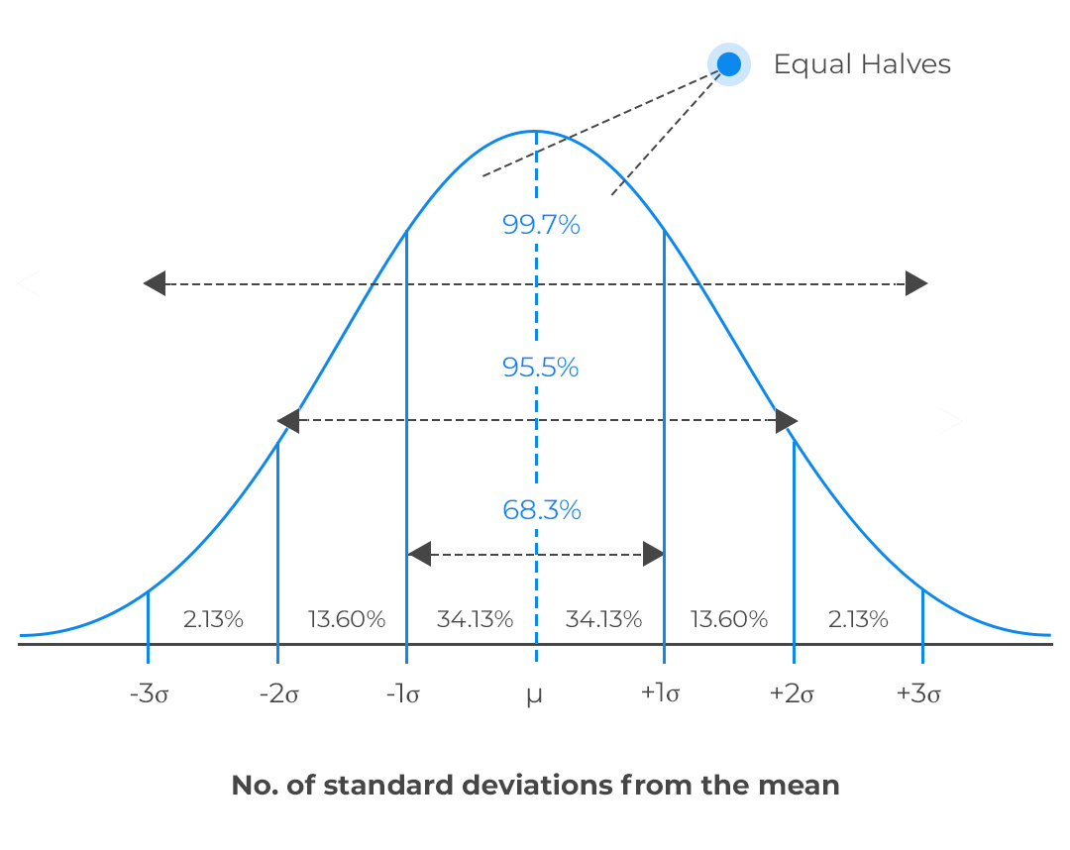
Normal or Gaussian Distribution
Gaussian distribution is a distribution in which values of a random variable are distributed symmetrically.
Often referred to as a bell-shaped curve
2/3 of observations are within 1 SD; 95% are within 2 SD
With large enough sample size, you can essentially draw distribution from mean and SD values
55 60 65 70 75 80 85
Notes:
Change x-axis to show real numbers

Slide 25
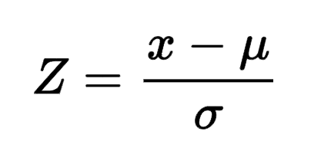
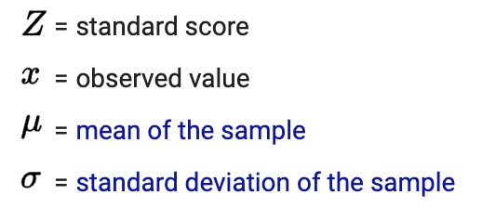
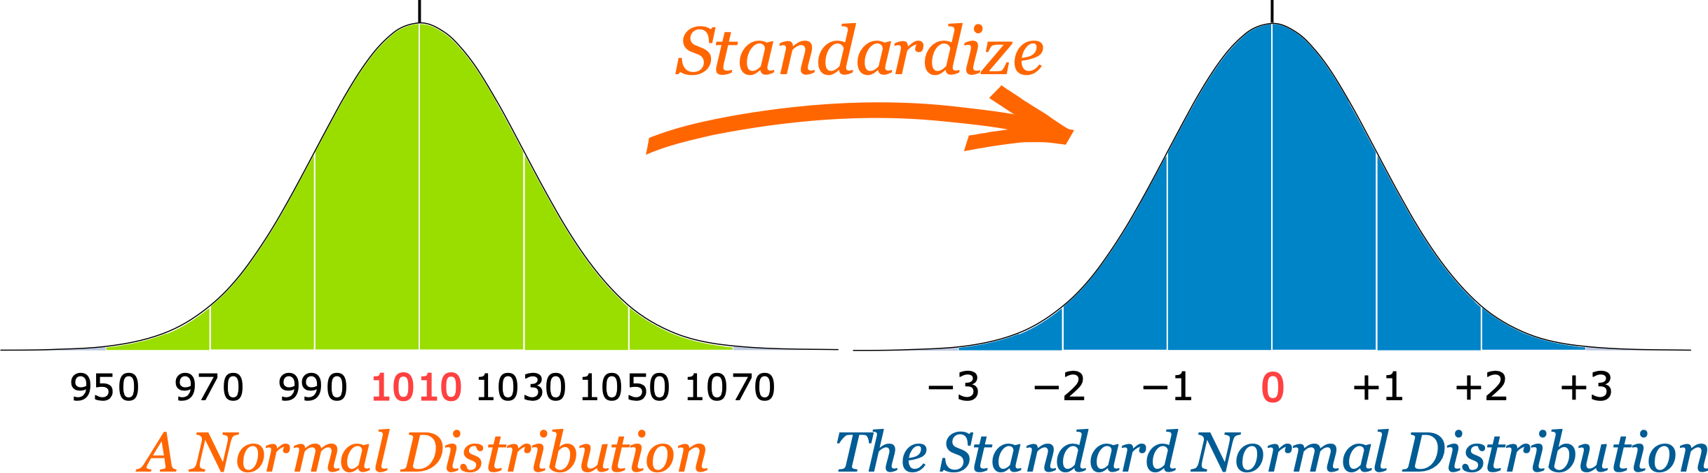
Standard Normal Distribution
Standard normal distribution is a normal distribution in which the mean is zero and SD = 1. Any normal distribution can be converted to standard through Z-score conversion:
Z-score tells you how many standard deviations your observation is from the mean
Notes:
x = observed value
Mu = sample mean
Sigma = sample sd

Slide 26
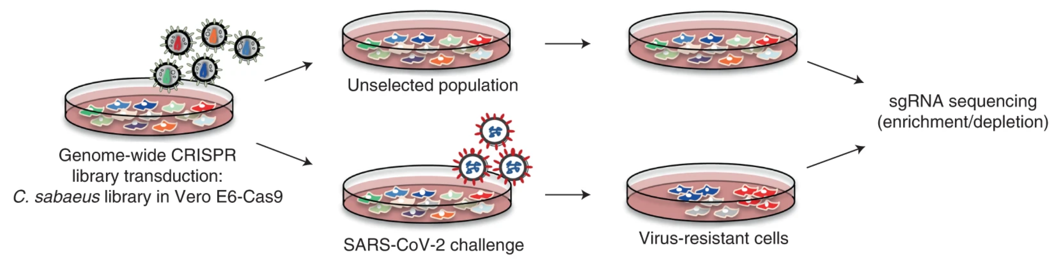
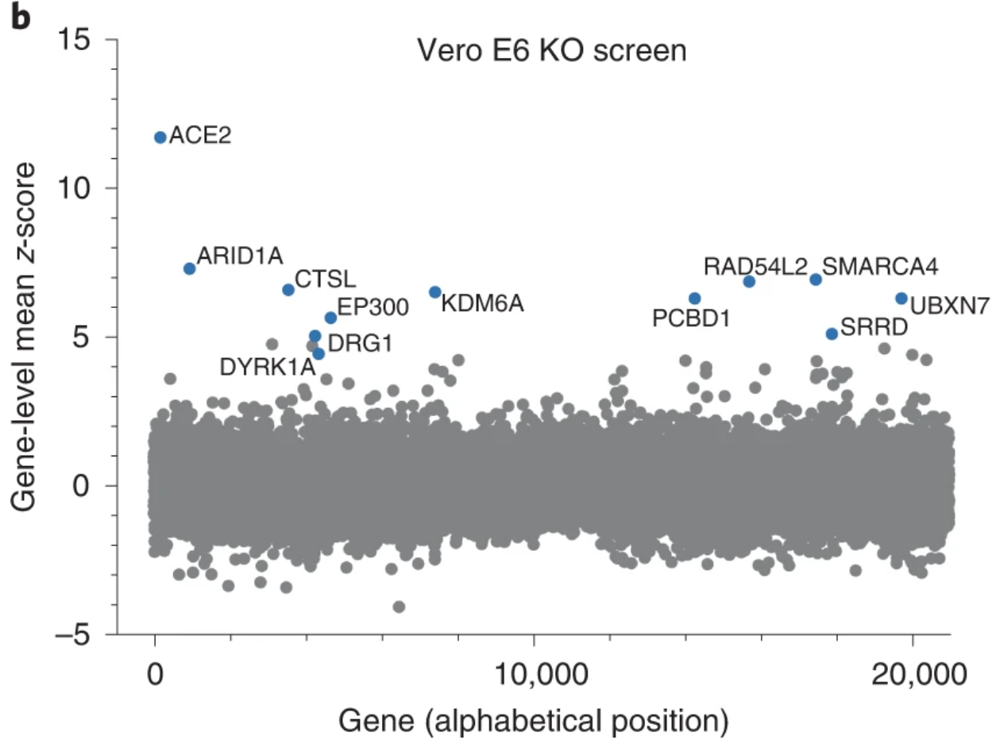
USE CASE: CRISPR Cas9 screening
Rebendenne et al., Nature Genetics 2022
Goal: Identify the regulators of SARS-CoV-2 infection by comparing guide enrichment in mock versus infected cell cultures
Normalizing data with Z-scores allows visualization of clear “hits” (i.e. blue dots)
Can also plot screen results using adjusted p-values, RSA scores, etc.

Slide 27
Biological Insight from Sample Population
Summarize information (Lecture 1)
Central tendency
Variation
Distributions
Confidence (Lecture 2)
Probabilistic statements
Hypothesis testings
p-values

